Slide 1
Ames Housing
Price Predictions
DSI-4 Project 02
Buy, sell, or HODL?
by Zhen Ming, Wei Hao, Kevin
Notes:
By kevin

Slide 2
Agenda
Background & Motivations
Problem Statement & Objectives
Model Highlights
Conclusions & Recommendations
Notes:
By kevin

Slide 3
Background
& Motivations
DSI-4 Project 02
What’s going on?
Notes:
By kevin

Slide 4
Background & MotiVations
What Bubble?...
In the early to mid 2000s, cheap credit and lax lending standards led to a booming Real Estate market.
This reduced barriers to entry, and fuelled housing sales volumes and prices.
This presents a great opportunity to purchase undervalued properties, and sell them off for a healthy profit.
Notes:
By kevin

Slide 5

Background & Motivations
Our Team.
Believe we can solve most problems with Data Science….
… And make money while we’re at it.
Notes:
By kevin
We have collected data of over 2000 houses of in Ames, Iowa
A predictive model was built to estimate the price of a house given its attributes.
We have identified key features of a great purchase, and also some strategies to improve our profit margins.

Slide 6
Problem & sOLUTION
DSI-4 Project 02
What are we going to do?
Notes:
By kevin

Slide 7

Problem Statement & Objectives
What is the problem?...
Over reliance on sentiment
Over reliance on realtors to provide valuations
Over or underestimation of fair value.
Notes:
By kevin
Home ownership is a highly sentimental subject.
Buyers and sellers resort to using intuition and ground sentiment during valuations.
Additionally, the lucrative market presents great opportunities for scheming realtors, providing over/under inflated valuations
On average, the process takes up to 7 days.
This poses a risk of over or underestimating the fair value of a flat, and also losing a potential client.

Slide 8

Problem & sOLUTION
Solution
Provide a quicker, more reliable estimate on housing prices using Machine Learning …
… And help home owners make informed decisions on their purchase.
Notes:
By kevin
Machine learning approach
Improves with more data collected
Able to keep track with trends quicker
Reliable
quick

Slide 9
Model Features
DSI-4 Project 02
What helps?...
… and what doesn’t?
Notes:
By WeiHao

Slide 10
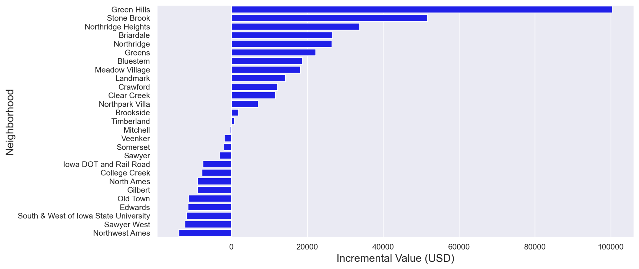
Model Features
Things to look out for…
Location, Location, Location…
Type of House
Size Does Matter
Kitchen & Exterior Quality
Age of House
Notes:
By WeiHao

Slide 11
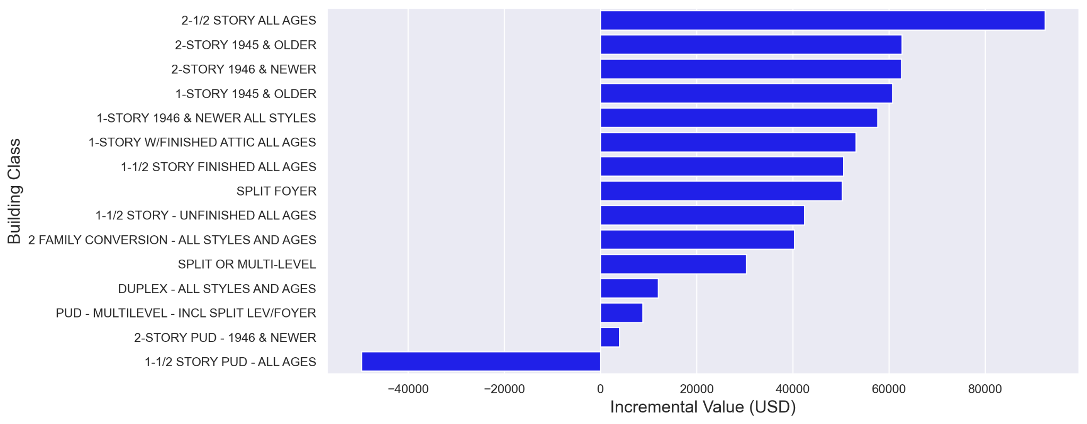
Model Features
Things to look out for…
Location, Location, Location…
Type of House
Size Does Matter
Kitchen & Exterior Quality
Age of House
Notes:
By WeiHao

Slide 12
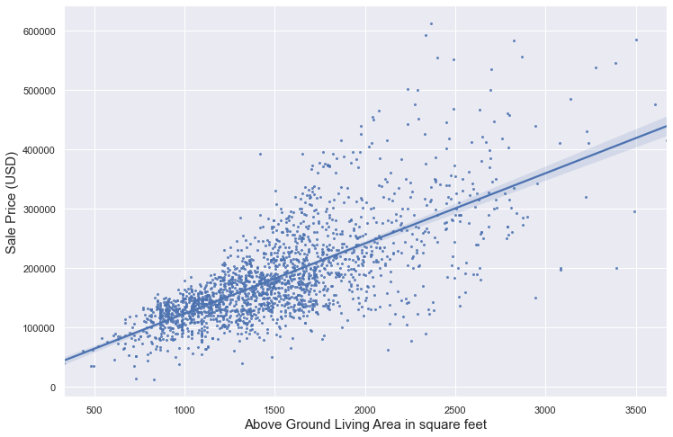
Model Features
Things to look out for…
Location, Location, Location…
Type of House
Size Does Matter
$51.6 per incremental SF
Kitchen & Exterior Quality
Age of House
Notes:
By WeiHao

Slide 13
Model Features
Things to look out for…
Location, Location, Location…
Type of House
Size Does Matter
Kitchen & Exterior Quality
Age of House
Kitchen Quality | Exterior Quality
Incremental Valuation (USD) | Incremental Valuation (USD)
$11,089 per rating increase | $11,581 per rating increase
Notes:
By WeiHao

Slide 14
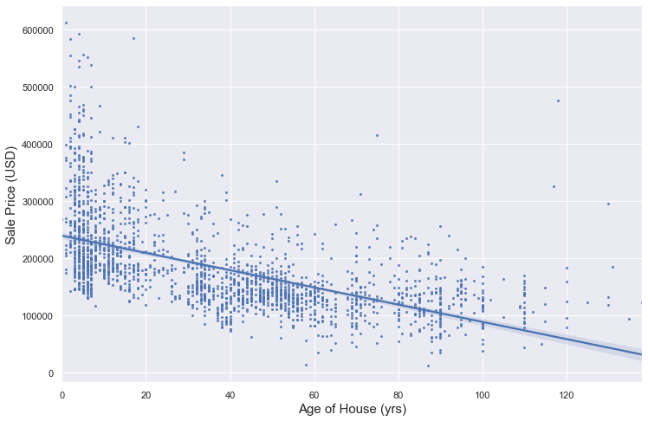
Model Features
Things to look out for…
Location, Location, Location…
Type of House
Size Does Matter
Kitchen & Exterior Quality
Age of House
-$5,489 per extra year older
Notes:
By WeiHao

Slide 15
Model usage
DSI-4 Project 02
Great. So how do we use it?
Notes:
By Zhen Ming

Slide 16
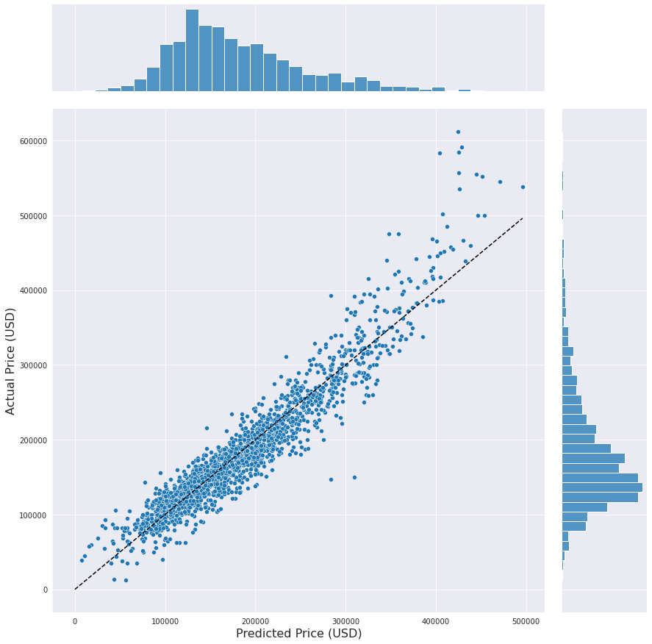
Model usage
RMSE: $ 24,969.18
MAE: $ 17,754.69
MAPE: 11.07%
R2: 0.9007
Identifying undervalued offers…
Dotted line represents the “Fair Value” lines
Prices most would be willing to pay, given housing attributes
Offers below the “Fair Value” line are considered under-valued
Margin of safety (MAPE & MAE)
Offer should be no more than 10-15% below the “fair value” line
$18,000 - $24,000
Notes:
By Zhen Ming

Slide 17
Fair Value
Sell Here
RMSE: $ 24,969.18
MAE: $ 17,754.69
MAPE: 11.07%
R2: 0.9007
Under valued
Profit Margin
Margin of Safety
Buy Here
Recommendation: Identify properties below the fair value line. After which, quote a selling price near the fair value line.
Notes:
By Zhen Ming

Slide 18
Model Breakdown
Low Volume
RMSE: $ 24,969.18
MAE: $ 17,754.69
MAPE: 11.07%
R2: 0.9007
Edge Cases…
Due to the lack of data, the model begins to break down at higher prices.
Occurs at ~ $380,000 and above.
Model begins to severely underpredict the actual sales prices.
However, due to the low volume, we can assume that these situations are rare and would not be typically encountered.
Recommendation: Avoid using this model for valuations above $380,000.
High Error
Notes:
By Zhen Ming

Slide 19
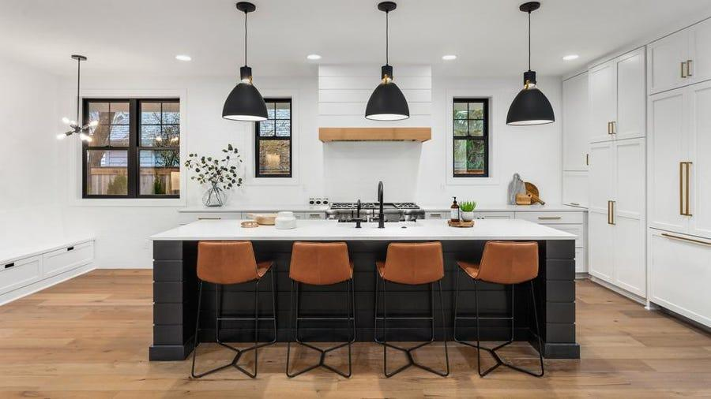
Applying Insights
RMSE: $ 24,969.18
MAE: $ 17,754.69
MAPE: 11.07%
R2: 0.9007
Kitchen Remodelling & Exterior Quality …
Kitchen & Exterior Quality…
Kitchen Quality: $11,089 per rating increase
Exterior Quality: $11,581 per rating increase
Cost Estimates:
Min Kitchen Remodel cost: $5,000 (Forbes)
Min Exterior Paint cost: $2,547 (Fixr.com)
Recommendation: Identify properties with undervalued kitchens, in a prime location. Conduct a cost-effective remodelling project for the house. Engage high school kids to help paint the exterior of the house.
Notes:
By Zhen Ming
https://www.forbes.com/advisor/home-improvement/kitchen-remodel-cost/
https://www.fixr.com/costs/paint-house-exterior

Slide 20
Conclusion & Recommendations
DSI-4 Project 02
Notes:
By Zhen Ming

Slide 21
Conclusions & Recommendations
RMSE: $ 24,969.18
MAE: $ 17,754.69
MAPE: 11.07%
R2: 0.9007
Identify undervalued properties within 10-15% of the fair value line
When valuing a house, pay close attention to…
Location, House type
Material of Construction
Kitchen Quality, Exterior Quality
House size.
Engage a interior designer as an advisor to provide estimates and feasibility recommendations on kitchen remodelling during house tours.
Focus on opportunities below $380,000.
Notes:
By Zhen Ming
https://www.forbes.com/advisor/home-improvement/kitchen-remodel-cost/
https://www.fixr.com/costs/paint-house-exterior

Slide 22
End
DSI-4 Project 1

